Slide 1

Web engineering
MYSQL DATaBASE

Slide 2




members
18sw34
18sw40
18sw121
18sw39
18sw124

Slide 3
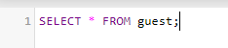
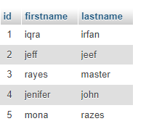
MySQL SELECT Statement
The SQL SELECT statement is used to fetch the data from a database table which returns this data in the form of a result table. These result tables are called result-sets.

Slide 4

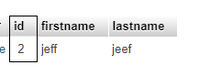
MySQL Where Class
The WHERE Clause is used to filter only those records that are fulfilled by a specific condition given by the user. in other words, the SQL WHERE clause is used to restrict the number of rows affected by a SELECT, UPDATE or DELETE query.

Slide 5
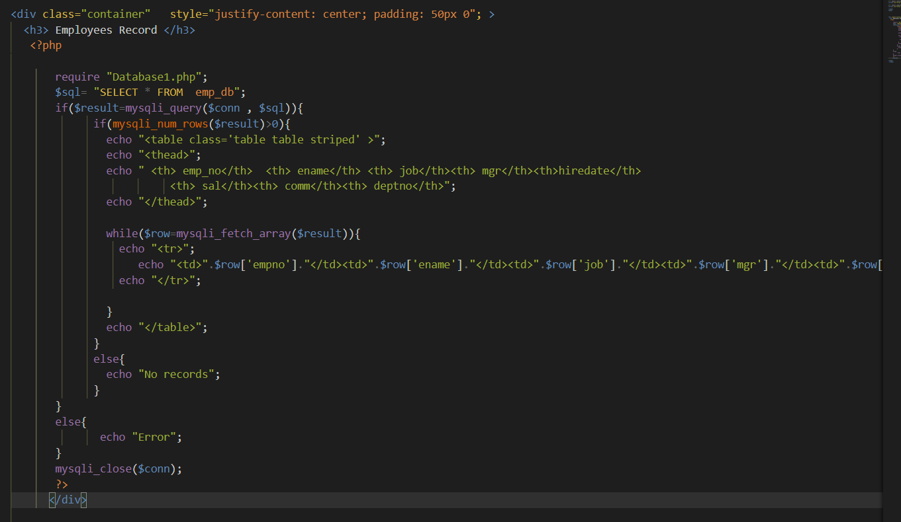

Slide 6
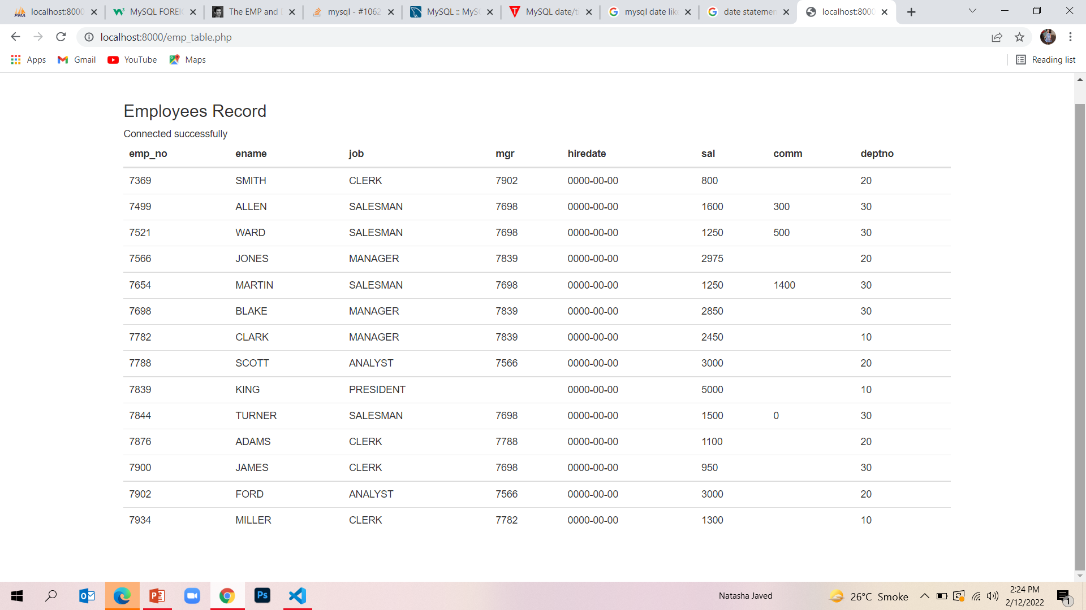

Slide 7
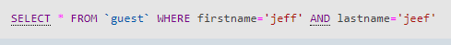
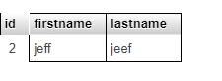
MySQL AND, OR and NOT Operators
The MySQL AND Condition (also called the AND Operator) is used to test two or more conditions in a SELECT, INSERT, UPDATE, or DELETE statement.

Slide 8
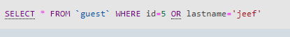
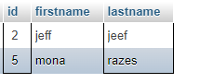
The MySQL OR Condition is used to test two or more conditions where records are returned when any one of the conditions are met.

Slide 9
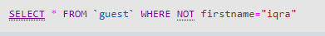
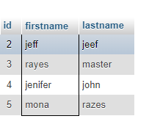
The NOT operator displays a record if the condition(s) is NOT TRUE.

Slide 10
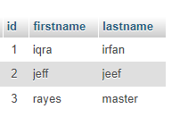
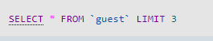
MySQL LIMIT Clause,
MySQL provides a LIMIT clause that is used to specify the number of records to return

Slide 11
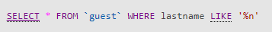
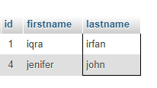
MySQL LIKE Operator
The LIKE operator is used in a WHERE clause to search for a specified pattern in a column.
There are two wildcards often used in conjunction with the LIKE operator:
The percent sign (%) represents zero, one, or multiple characters.
The underscore sign (_) represents one, single character.

Slide 12
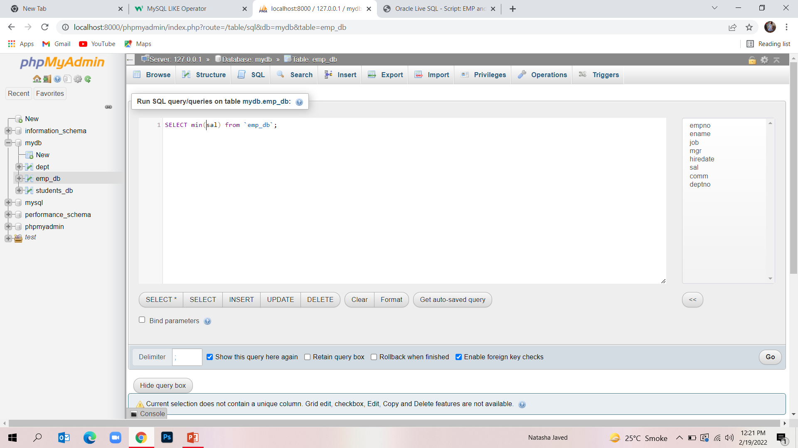
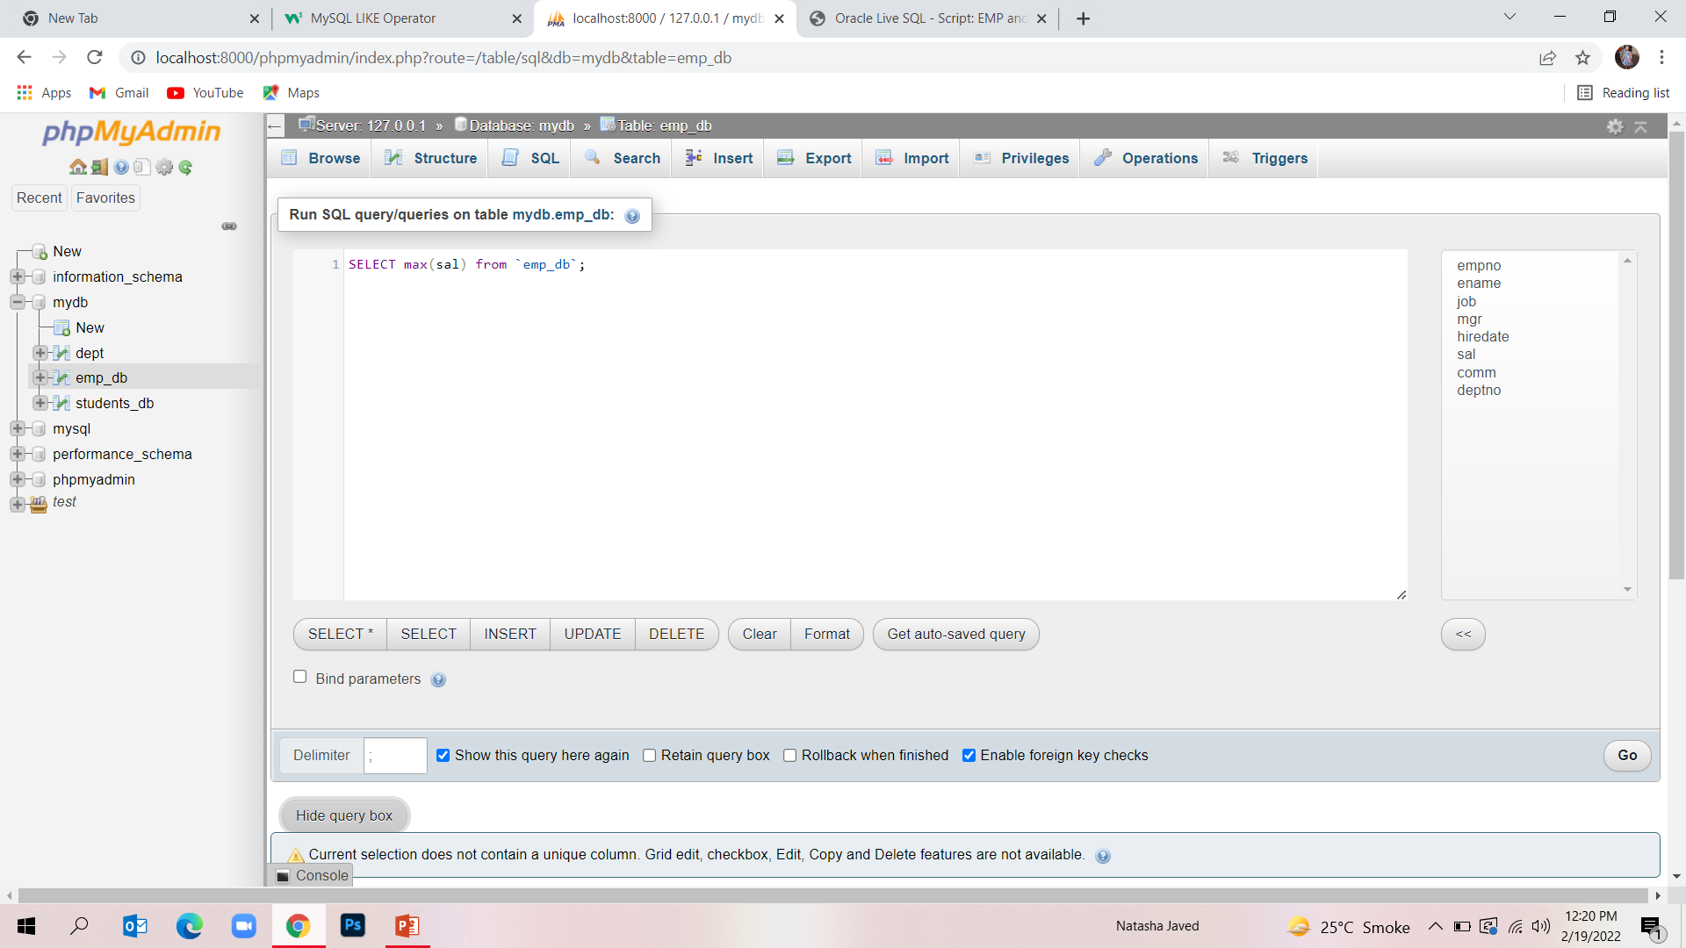
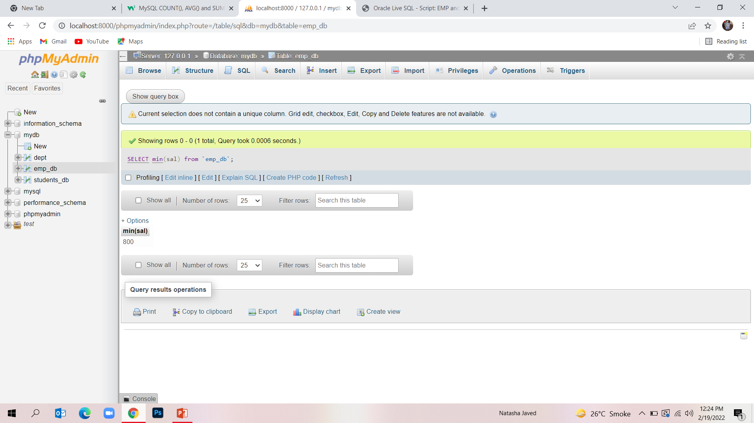

MySQL MIN() and MAX() Functions
The MIN() function returns the smallest value of the selected column. The MAX() function returns the largest value of the selected column.

Slide 13
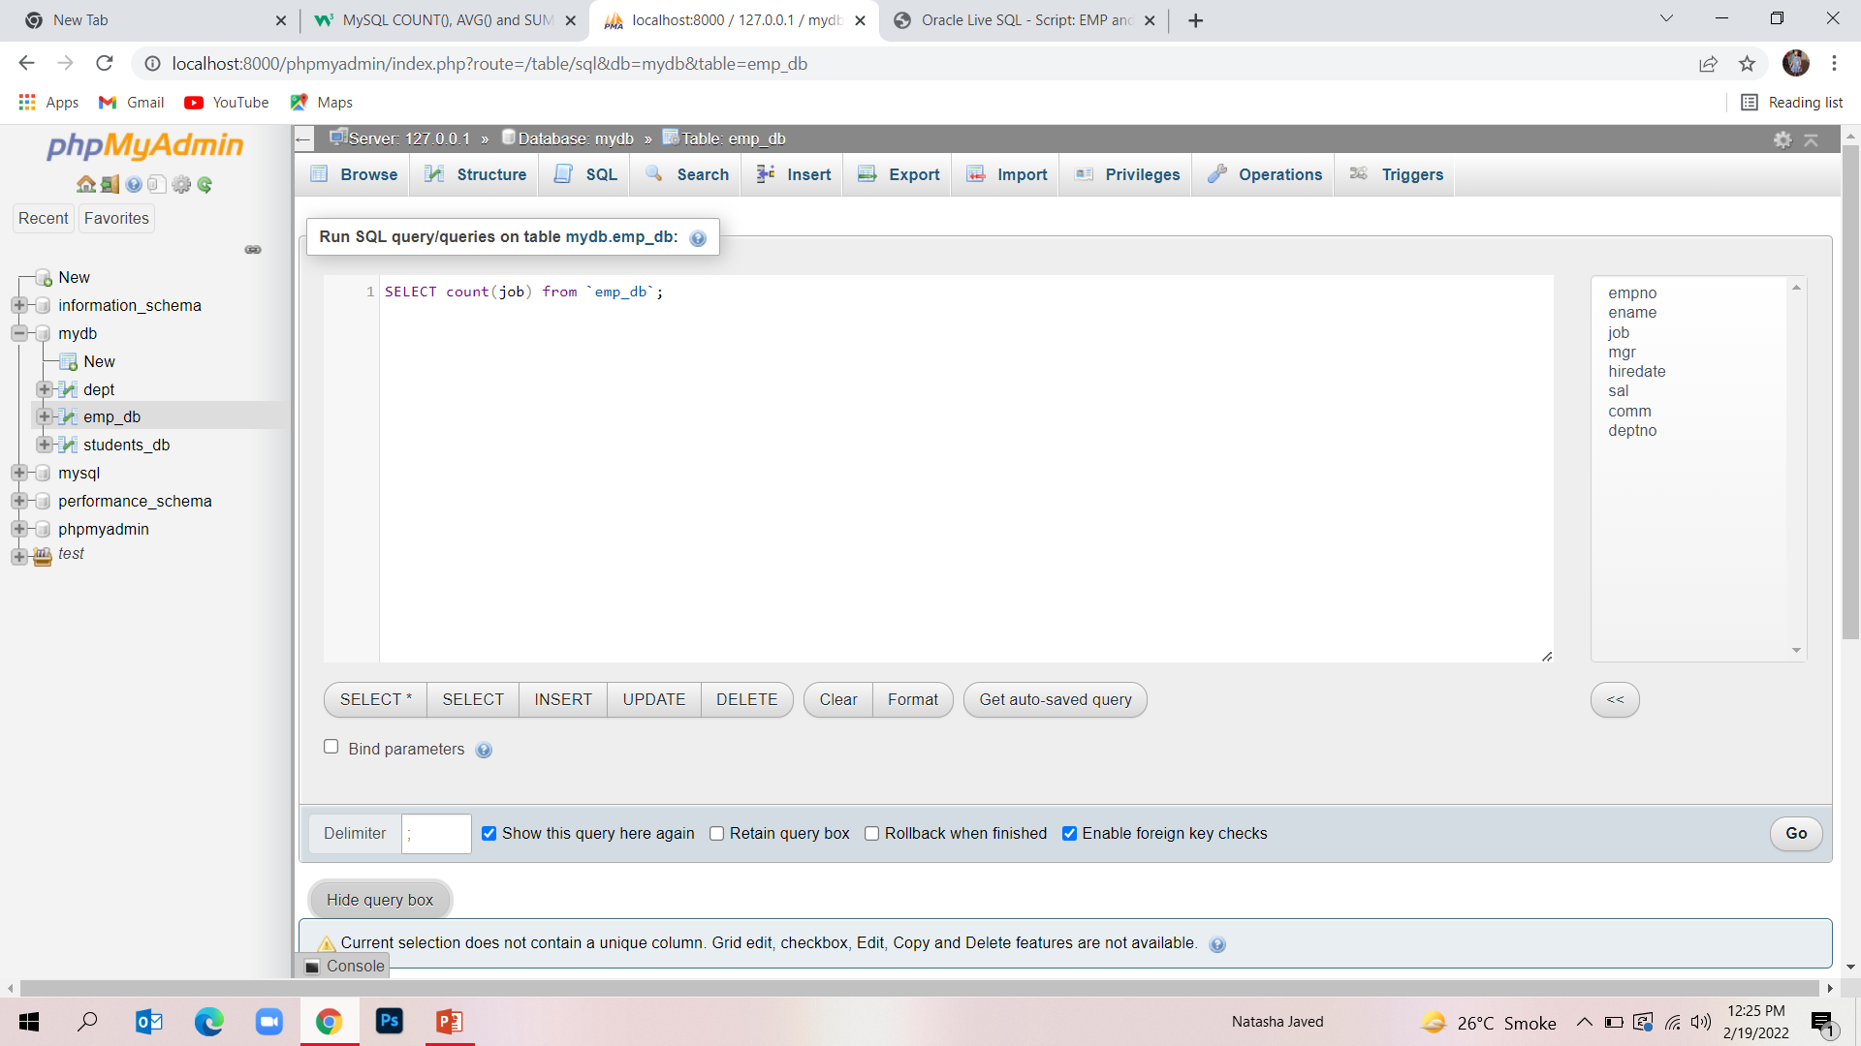
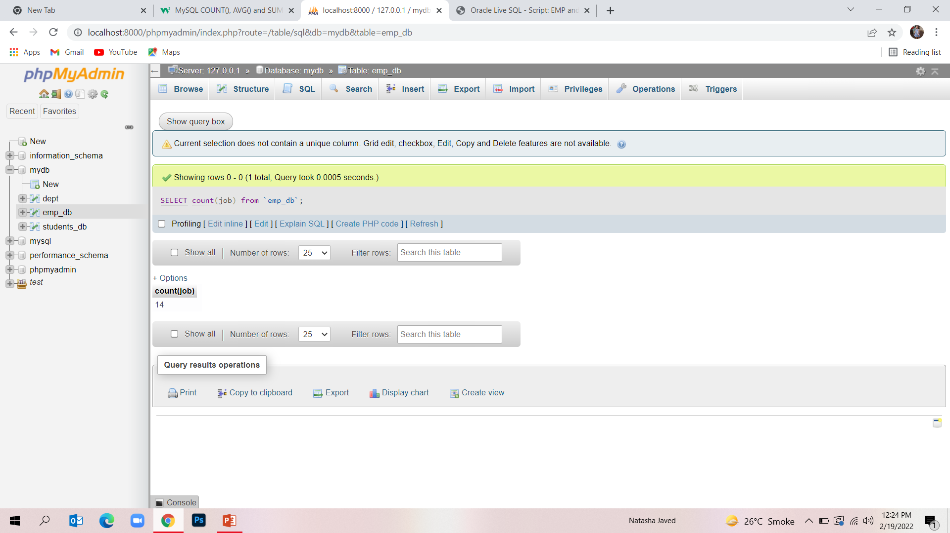
MySQL COUNT(), AVG() and SUM() Functions
The COUNT() function returns the number of rows that matches a specified criterion

Slide 14

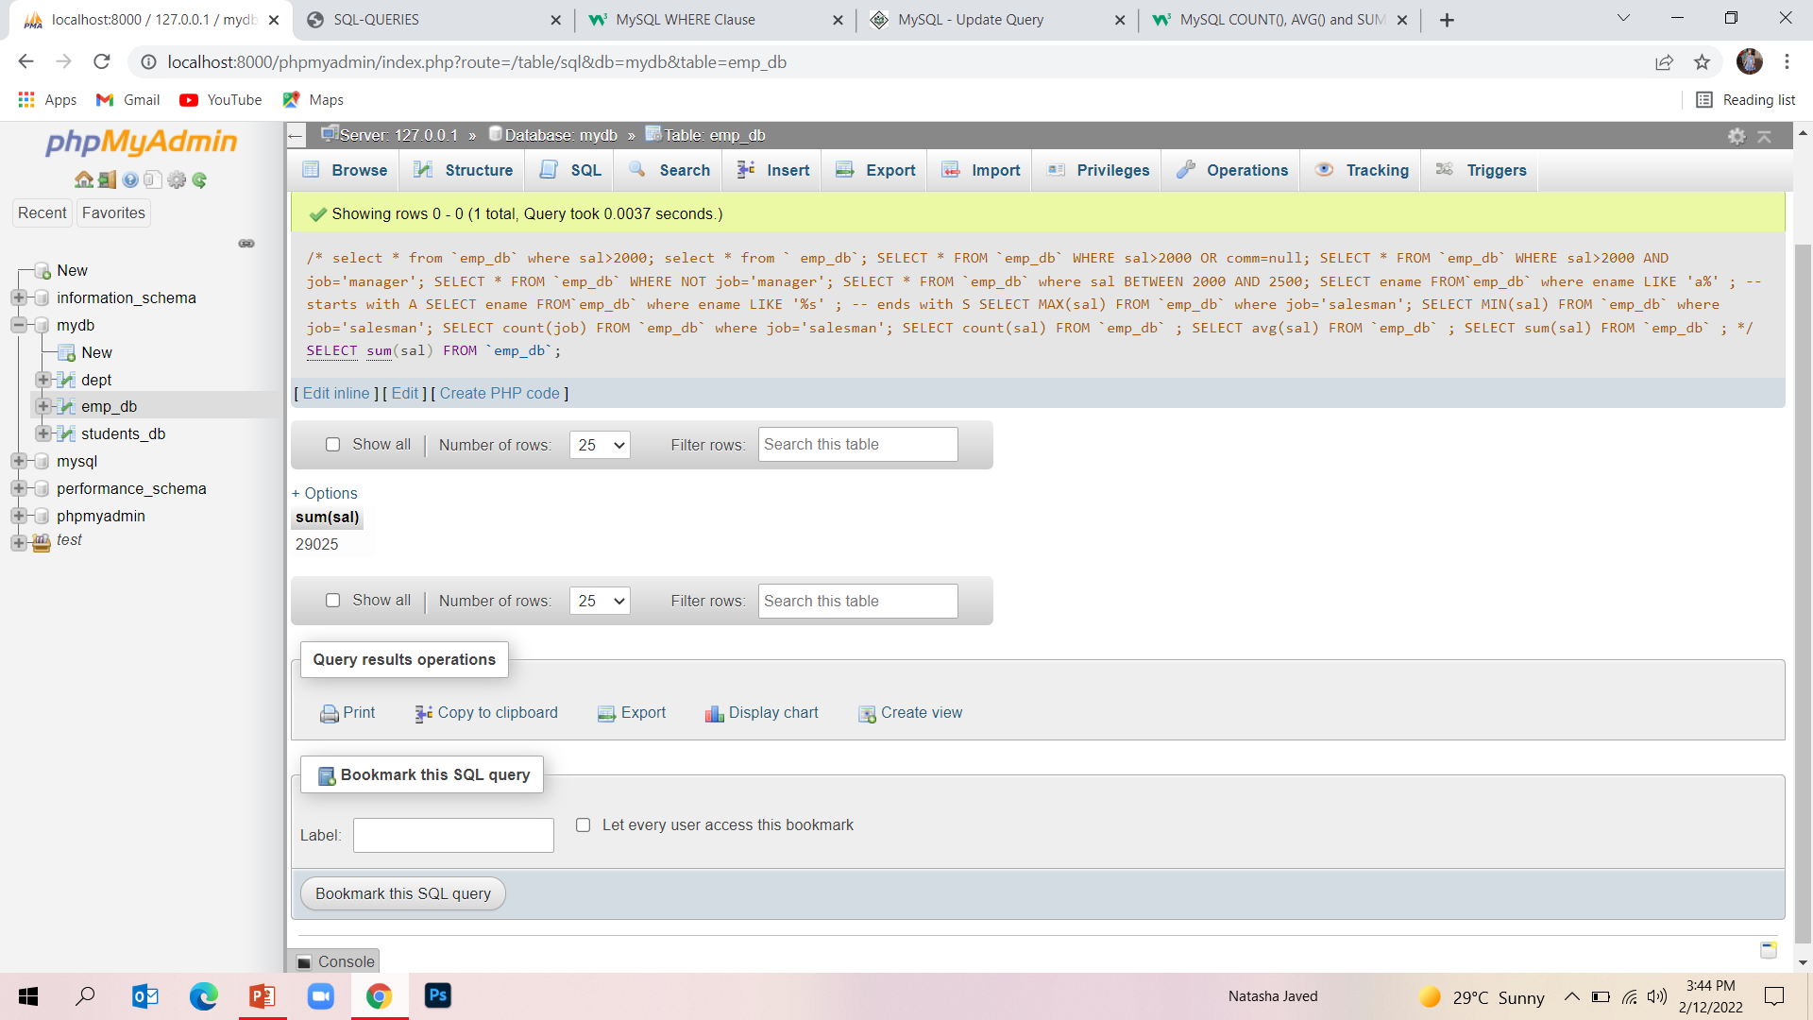
Sum: The SUM() function returns the total sum of a numeric column.

Slide 15

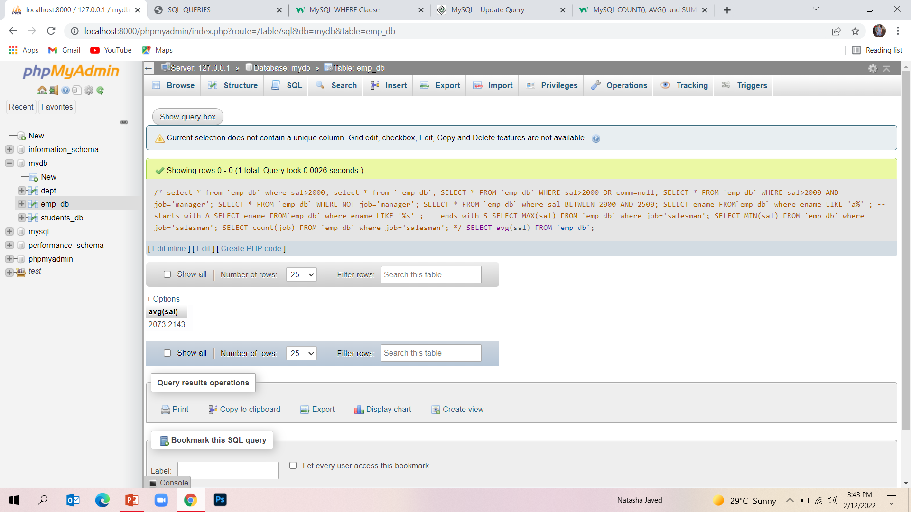
Avg : The AVG() function returns the average value of a numeric column.

Slide 16
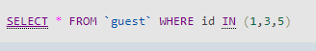
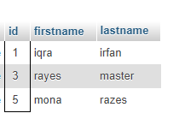
MySQL IN OperatoR
The IN operator allows you to specify multiple values in a WHERE clause.
The IN operator is a shorthand for multiple OR conditions.

Slide 17
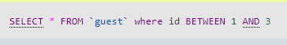
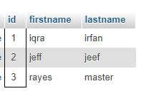
MySQL BETWEEN Operator
The BETWEEN operator selects values within a given range. The values can be numbers, text, or dates.

Slide 18
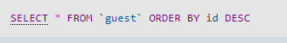
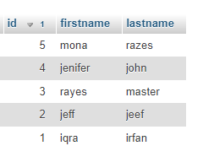
MySQL ORDER BY Keyword
The ORDER BY keyword is used to sort the result-set in ascending or descending order. The ORDER BY keyword sorts the records in ascending order by default.

Slide 19
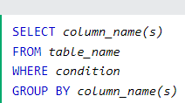
MySQL GROUP BY Statement,
The GROUP BY statement groups rows that have the same values into summary rows, like "find the number of customers in each country".
The GROUP BY statement is often used with aggregate functions (COUNT(), MAX(), MIN(), SUM(), AVG()) to group the result-set by
one or more columns.

Slide 20
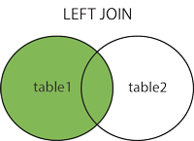
Joins
A JOIN clause is used to combine rows from two or more tables, based on a related column between them.
INNER JOIN: Returns records that have matching values in both tables
LEFT JOIN: Returns all records from the left table, and the matched records from the right table
RIGHT JOIN: Returns all records from the right table, and the matched records from the left table
CROSS JOIN: Returns all records from both tables

Slide 21
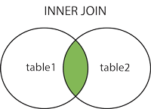
Inner join
The INNER JOIN keyword selects records that have matching values in both tables

Slide 22
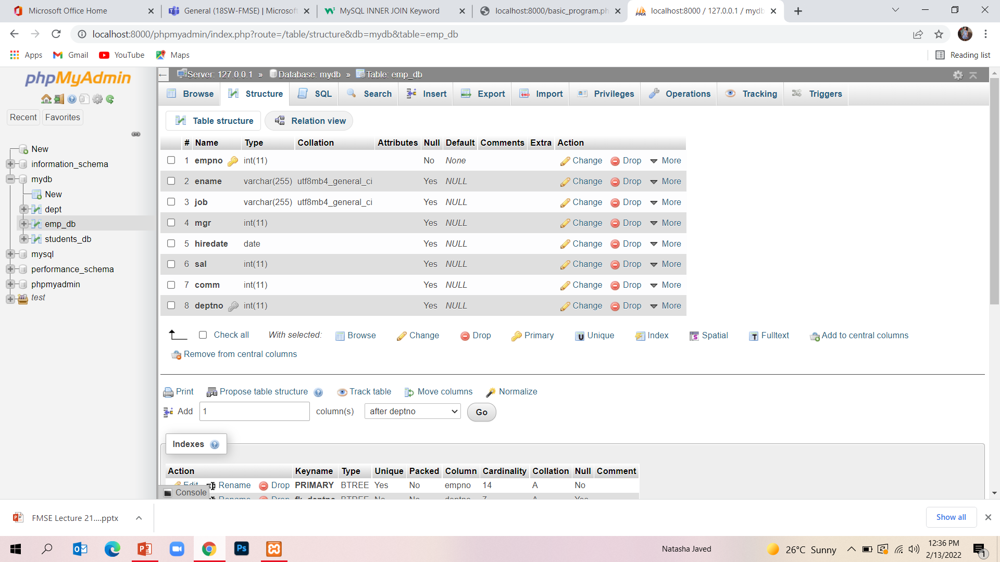
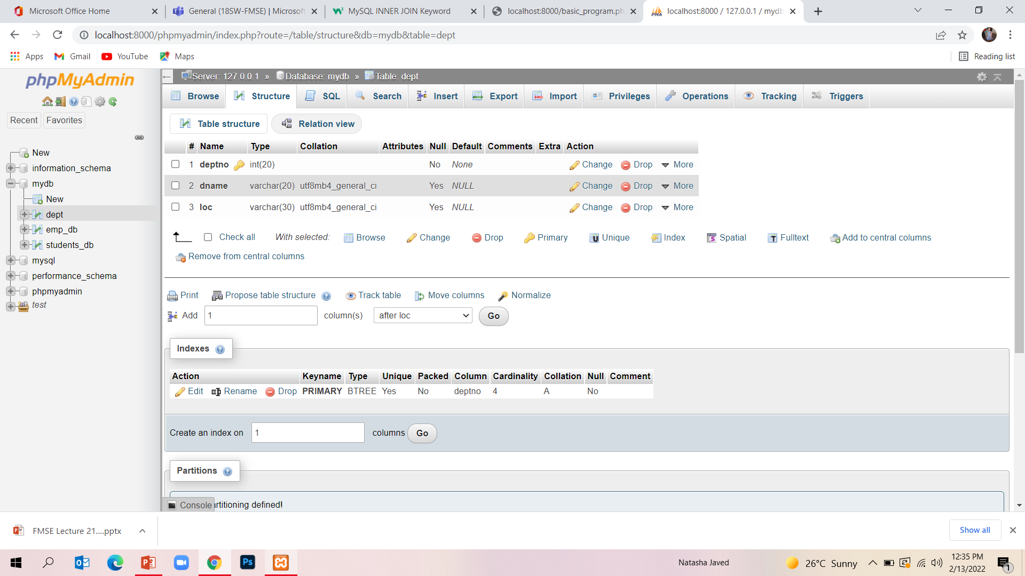
Inner join

Slide 23
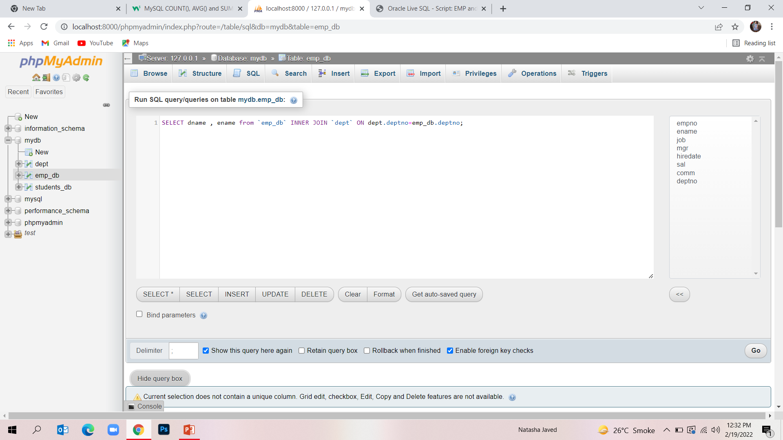
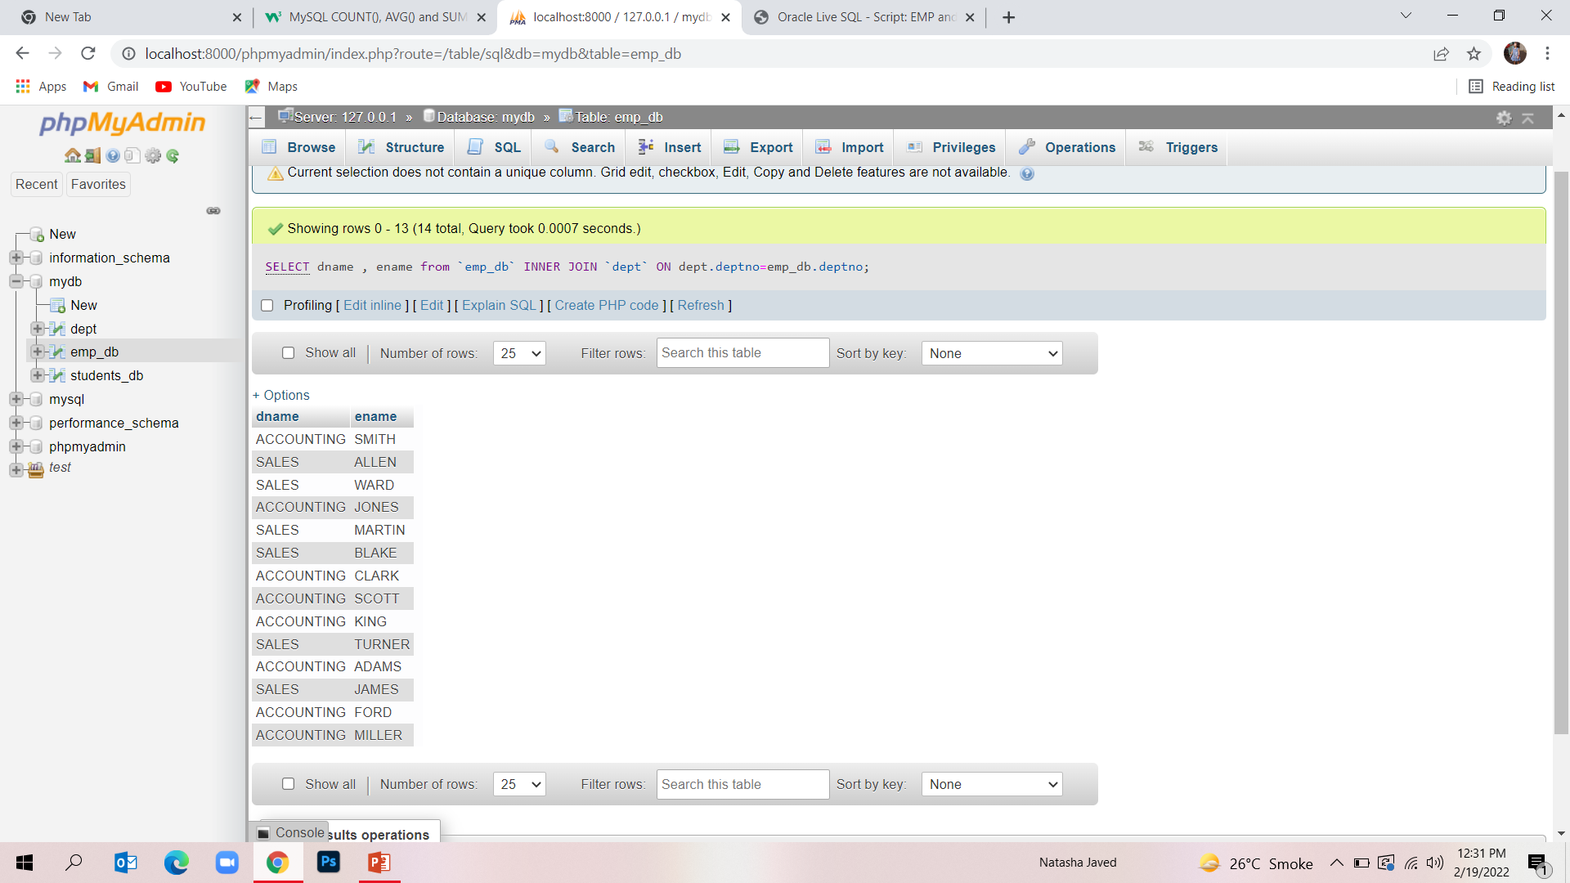
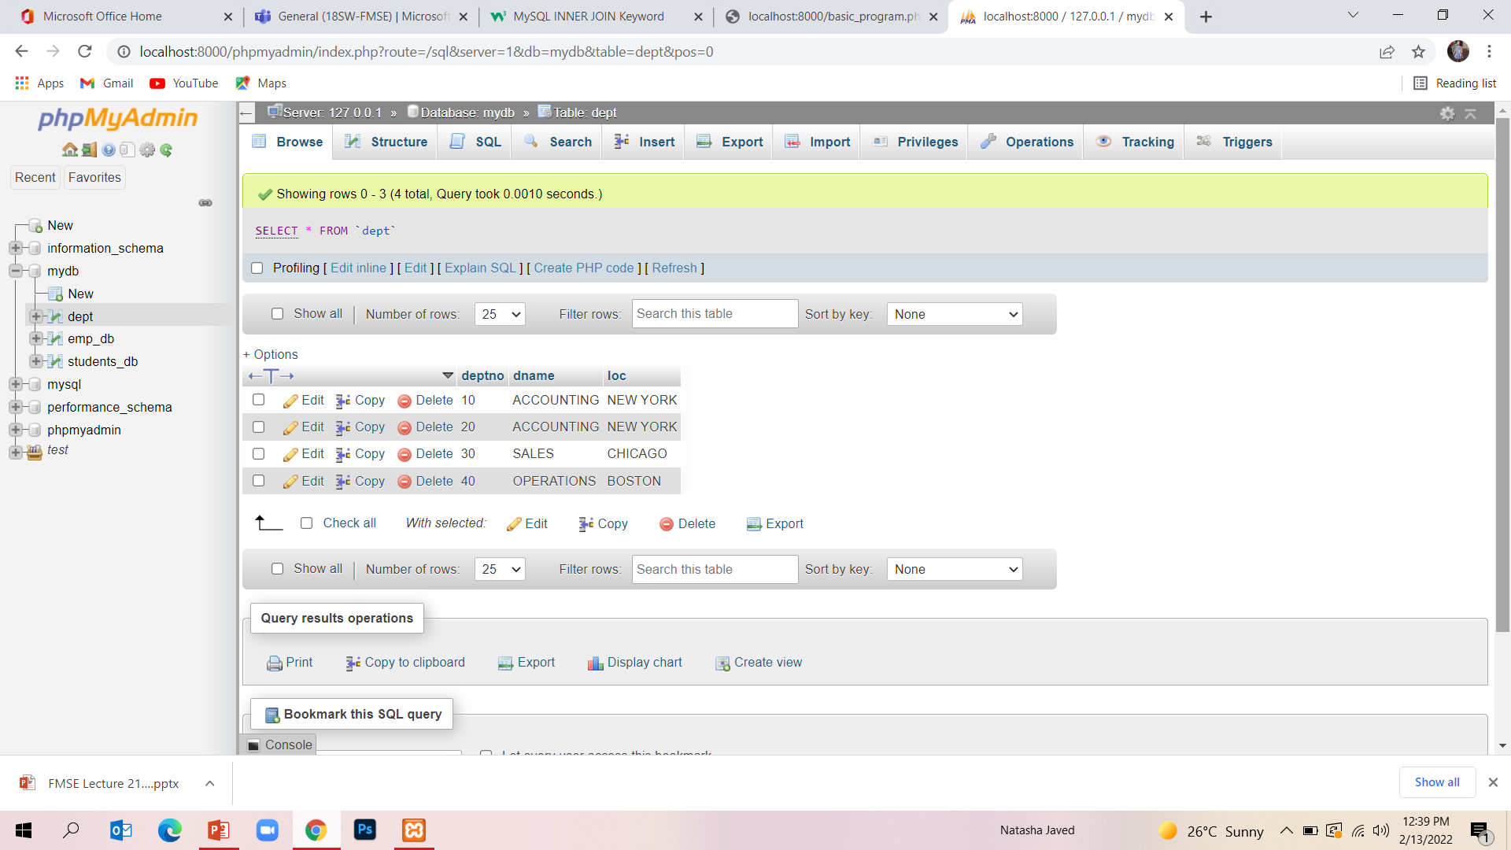
Inner join

Slide 24
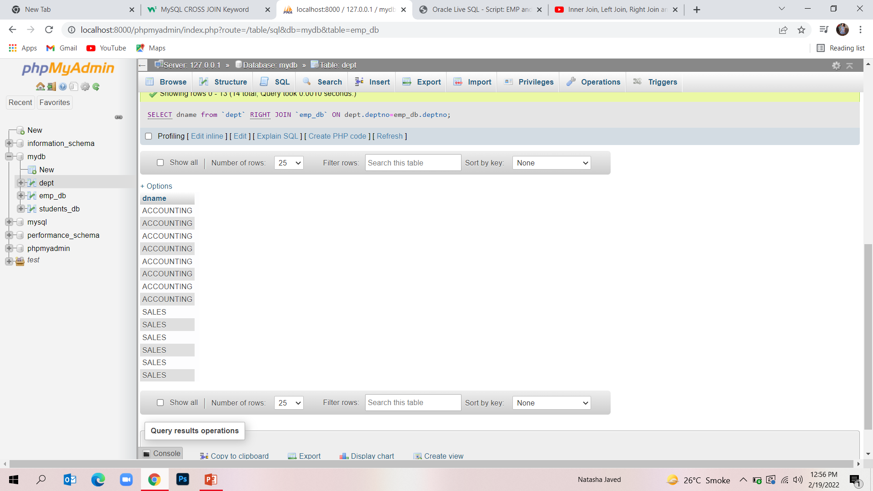
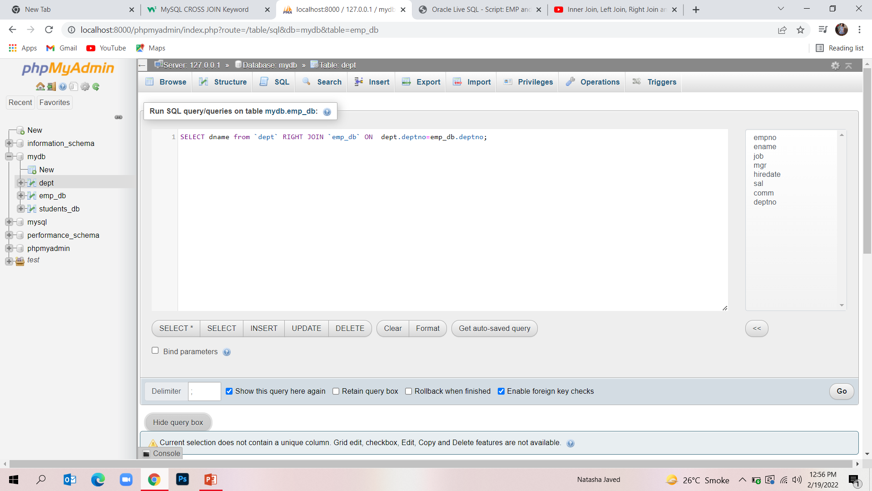
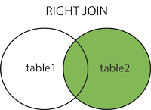
Right join

Slide 25
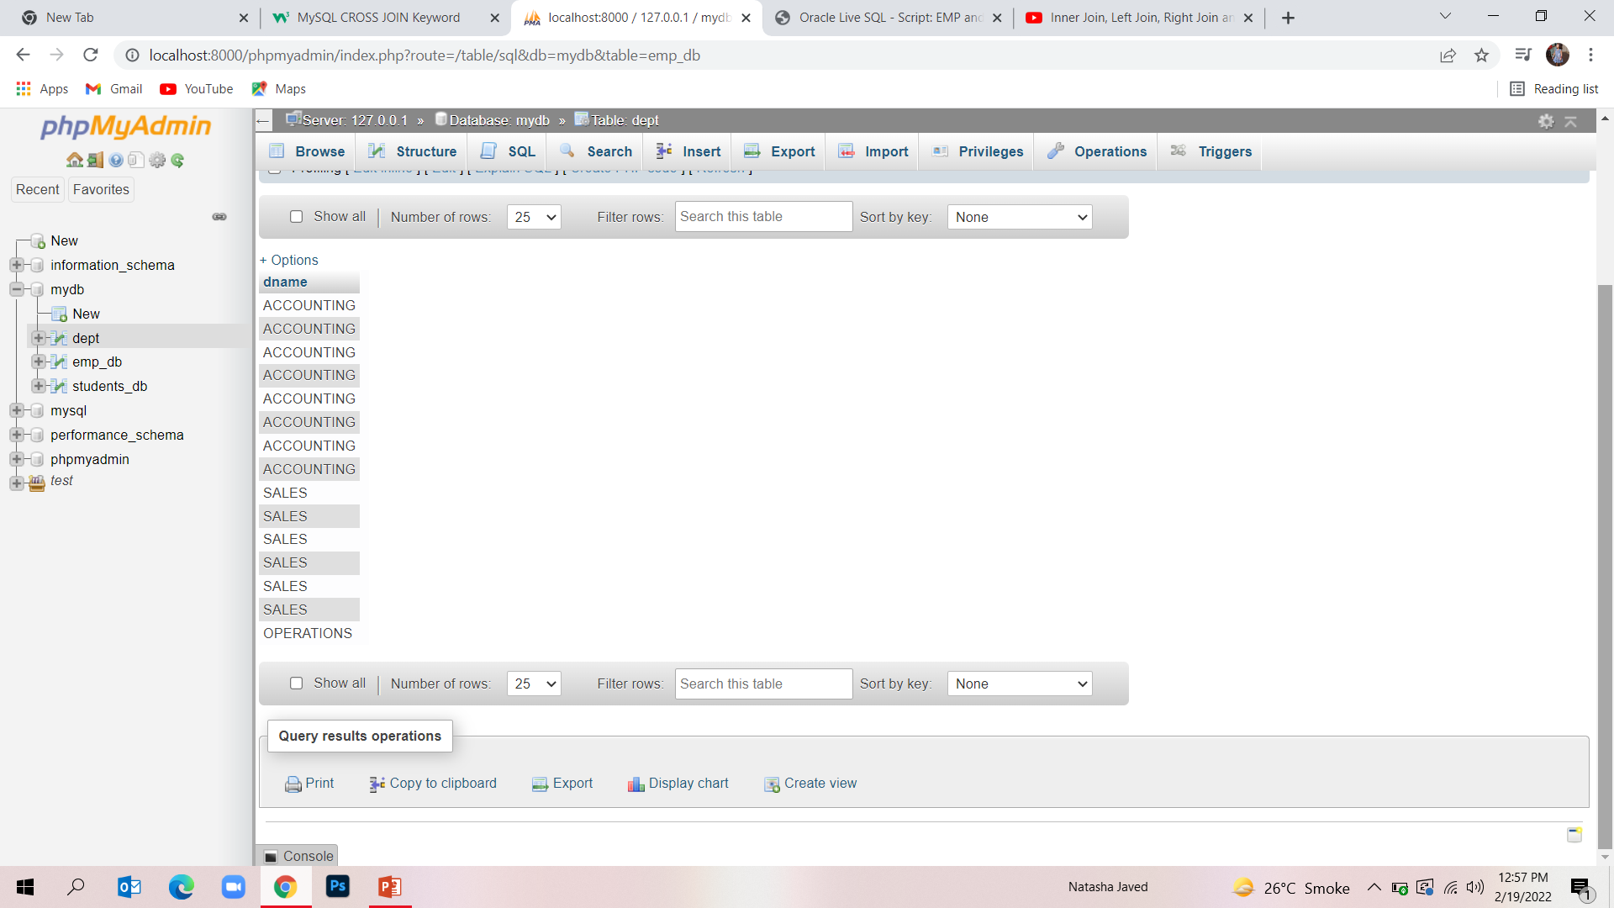
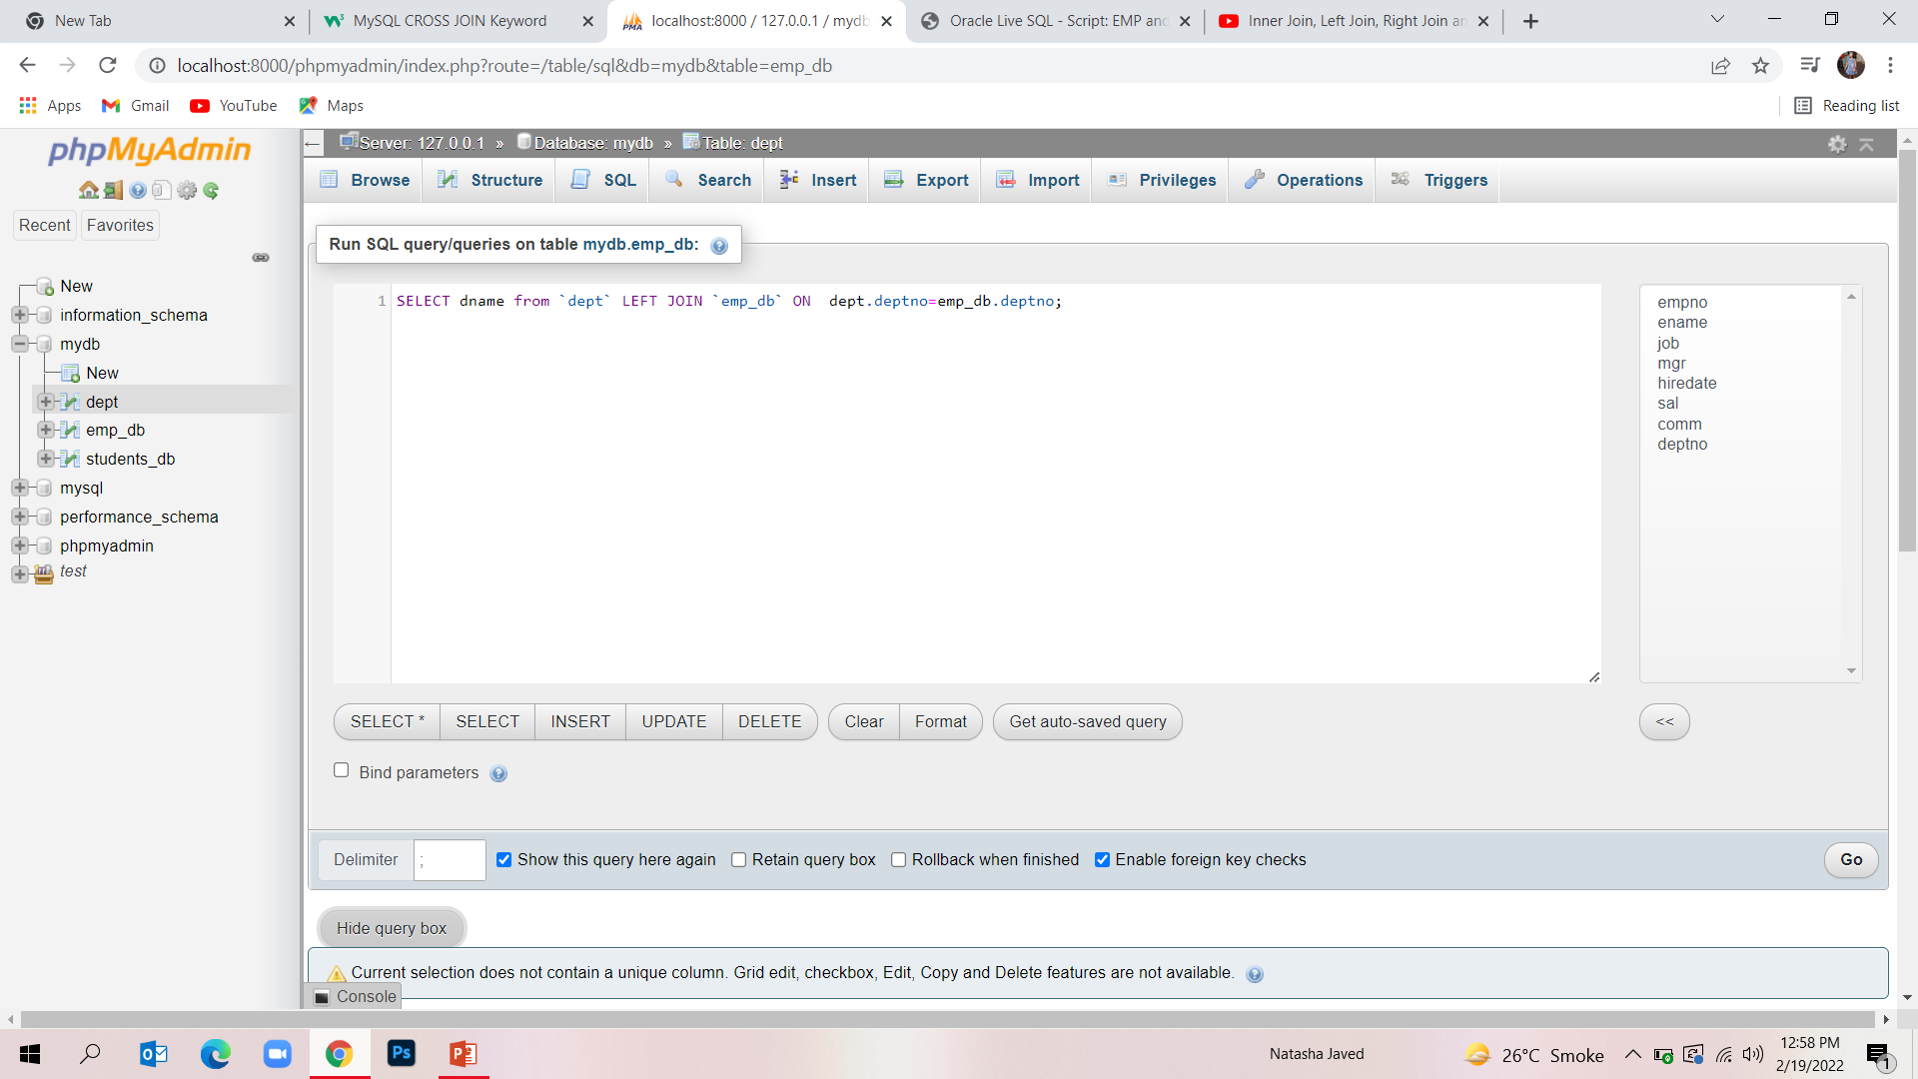
Left join
The LEFT JOIN keyword returns all records from the left table (table1), and the matching records (if any) from the right table (table2).

Slide 26
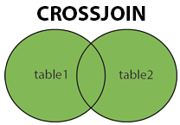
Cross join
The CROSS JOIN keyword returns all records from both tables (table1 and table2).

Slide 27
MySQL Constraints
Constraints can be specified when the table is created with the CREATE TABLE statement, or after the table is created with the ALTER TABLE statement.
The following constraints are commonly used in SQL:
NOT NULL - Ensures that a column cannot have a NULL value
UNIQUE - Ensures that all values in a column are different
PRIMARY KEY - A combination of a NOT NULL and UNIQUE. Uniquely identifies each row in a table
FOREIGN KEY - Prevents actions that would destroy links between tables
CHECK - Ensures that the values in a column satisfies a specific condition
DEFAULT - Sets a default value for a column if no value is specified
CREATE INDEX - Used to create and retrieve data from the database very quickly

Slide 28
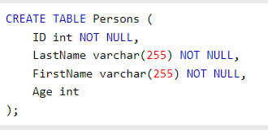
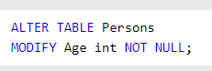
MySQL NOT NULL

Slide 29
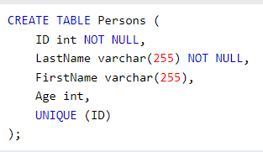
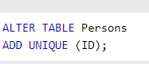
MySQL UNIQUE Constraint
you can have many UNIQUE constraints per table

Slide 30
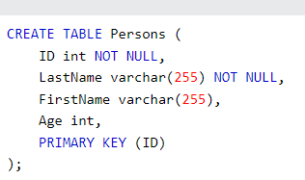
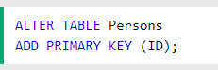
MySQL PRIMARY KEY Constraint

Slide 31
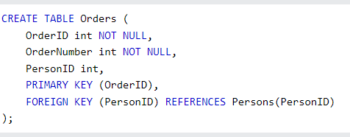
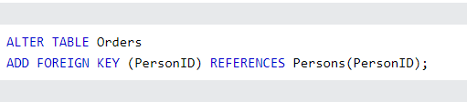
MySQL FOREIGN KEY Constraint
A FOREIGN KEY is a field (or collection of fields) in one table, that refers to the PRIMARY KEY in another table.

Slide 32

Thank You!🙂

